Slide 1
Date Time API
Shristi Technology Labs

Slide 2
Contents
LocalTime
LocalDate
LocalDateTime
ZonedDateTime
Period
Duration

Slide 3
Date Time API
Is from java.time package
Is ThreadSafe
Supports Local and Zonal timezones
TemporalAdjustments are possible
Chrono units for getting day, month and year
Notes:
Old datetime API is not thread safe
had less direct methods for date operations.
Developers had to write a lot of code to deal with timezone issues.

Slide 4
Classes
LocalDate
LocalTime
LocalDateTime
ZonedDateTime
ZoneId
Period
Duration

Slide 5
LocalDate
represents a date in ISO format (yyyy-MM-dd) without time.
It can be used to store dates like birthdays and paydays.
Can get a specific day, month and year using the of method
Can convert a date in String to date format using parse method.
Has utility methods to add/ subtract days, month, years
Can get the time interval(Period) between two days
LocalDate date = LocalDate.now();

Slide 6
LocalTime
represents time without a date.
An instance of LocalTime can be created from system clock or by using parse and of method
Can get hour, minute and second units using the of method
Can convert time in String to hour/minute using parse method.
Has utitlity methods to add/ subtract hours, minute,seconds
Can get the time interval(Duration)
LocalTime time = LocalTime.now();

Slide 7
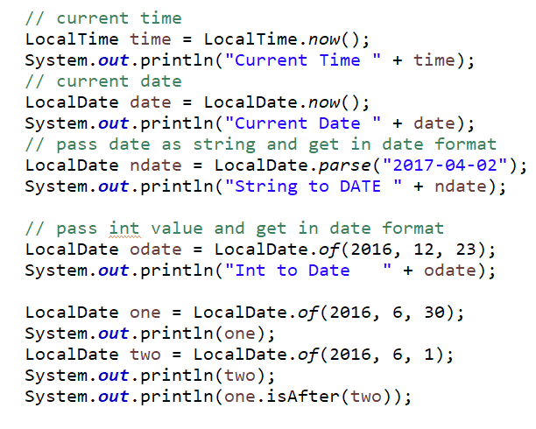
Example

Slide 8
LocalDateTime
is used to represent a combination of date and time.
is the most commonly used class
Also has of, parse, plus, minus methods
LocalDateTime datetime = LocalDateTime.now();

Slide 9
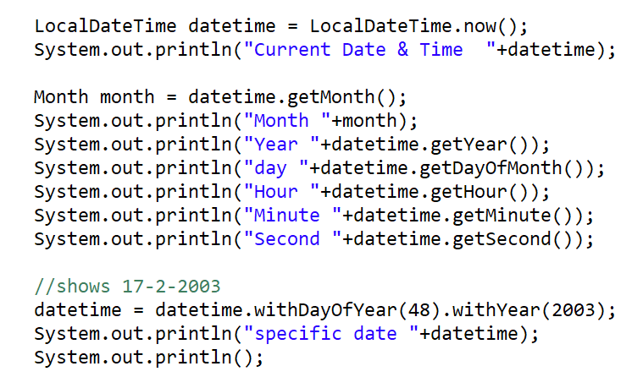
Example

Slide 10
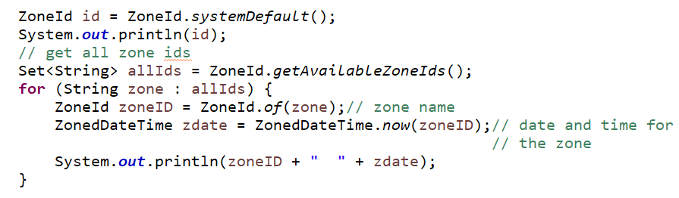
ZonedDateTime
ZonedDateTime is used with time zone specific date and time.
ZoneId is an identifier to represent different zones. (about 40 different time zones
ZoneId zoneId = ZoneId.of("Europe/Paris");
ZoneId id = ZoneId.systemDefault();
ZonedDateTime zdate = ZonedDateTime.now(zoneID);

Slide 11
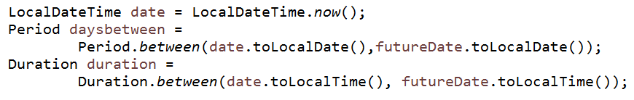
Period & Duration
Period
Gives the time interval in terms of years, months and days
use the between() method of the ChronoUnit class
Duration
Gives the time interval in terms of seconds and nano seconds.

Slide 12
Summary
LocalTime
LocalDate
LocalDateTime
ZonedDateTime
Period
Duration

Slide 13
Thank you

